Slide 1
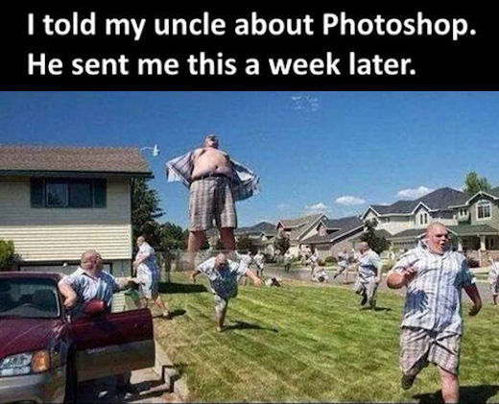
Adobe Creative Sweeeeet!
The Basics of Adobe Creative Suite

Slide 2
How to Get Adobe Creative Suite
30-Day Free Trial
Student and Teacher discounts
Creative Cloud Subscription ($49.99/mo)
Latest Photoshop, Illustrator, and More, plus Cloud Features
Creative Cloud Photography Subscription ($9.99/mo)
Just Photoshop and Lightroom, plus Lightroom mobile and web
Always look for coupons and first-year deals!!

Slide 3
The Programs
These Adobe Programs are used for a variety of different tasks.
Notes:
Photoshop: photo manipulation
Encore: DVD authoring program
After Effects: motion graphics
Premiere: Video editing
InDesign: Page formatting and layouts
Flash: Flash animation software
Flash builder: Can build games and other flash
Illustrator: best for graphic design, one-page
Bridge: Stores media
Fireworks: bitmap and vector graphics software
Dreamweaver: Web development tool
Audition: Sound design
SpeedGrade: color correction software
Prelude: to review, import, and export tapeless media
Lightroom: Digital photography software

Slide 4
What do these programs do?
Photoshop: Photo manipulation
Encore: DVD authoring program
After Effects: motion graphics
Premiere: Video editing
InDesign: Page formatting and layouts
Flash: Flash animation software
Flash builder: Can build games and other flash programs
Illustrator: Best for graphic design one-page layouts
Bridge: Can store and view media in Bridge
Fireworks: Bitmap and vector graphics software
Dreamweaver: Web development tool
Audition: Sound design
SpeedGrade: Color correction software
Prelude: To review, import, and export tapeless media
Lightroom: Digital photography software

Slide 5
Why not just buy one program?
All of the Adobe Creative Suite programs work together
Each program performs a specific task very well
But combining them is easy, as most files are multi-platform compatible
You might want to edit a picture in Photoshop, and then put it into your newsletter that you’re working on in InDesign.
The entire Creative Suite is designed for media output as a whole, not as just one or two programs.

Slide 6
Adobe Photoshop CC 2015
Photo manipulation tool
What’s New in CC 2015?
Artboards, similar to Illustrator
New Layer Styles
iOS Preview support
3D Printable content simplified
Faster, easier image export
Content-Aware Fill panoramas improved

Slide 7
Why Photoshop?
New features enhance productivity, creativity.
Simple to use software, but can be more technical when needed

Slide 8
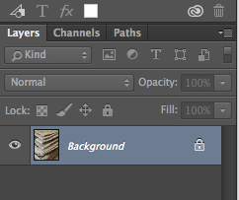
Toolbars and More
Almost every tool you will use comes from the toolbar on the side of Photoshop. Most Adobe programs have the same or similar toolbar on the side. It has things as simple as the Move tool and the Eraser tool, to as precise as the Clone Stamp Tool.
The Layers panel shows your active layers, and any effects that may be on the layers. You can do color changes, insert effects, and more with the layers tool. It is an effective way to separate elements in Photoshop.
TIP: Always remember to name your layers, so you know what they are! Double check that you’re working on the right layer!

Slide 9
Photoshop can be used to…
Add makeup and retouch pictures slightly or drastically, and more!

Slide 10
Adobe InDesign CC 2015
Document layout designer
Why use InDesign?
More functionality and control than Word
Layout tools intuitive
Templates ideal for magazines and other multi-page designs
Create interactive PDFs easily
What’s new with CC 2015?
PDF Defaults improved
Easily publish documents online

Slide 11
Why InDesign?
Easy, intuitive document builder, with lots of layout tools.
Guidelines and layout tools make formatting easy
Quickly view pages and create templates

Slide 12
Simply view all links and pages
Create simple interactive PDFs
Guidelines keep formatting clean
Text formatting simple, can easily change kerning, spacing, and width of letters, as well as select font and spacing

Slide 13
Adobe Premiere Pro CC 2015
Video Editing Software
Useful for pros and rookies alike
What’s new in CC 2015?
Morph Cut Transition
Touchscreen-friendly interface
Audio workflows improved

Slide 14
Why Premiere?
Simple editing program with lots of features.
Easily integrate AfterEffects graphics

Slide 15
Premiere has…
Timeline (left) with multiple tracks, to allow tight editing
Storage bins for media, imported easily
A preview window for easy access
Built-in effects and transitions for both audio and video
Fluid workspace based on preferences of the editor

Slide 16
Adobe Illustrator CC 2015
Logo and illustration software
Artboards allow you to make flyers, certificates, etc.
What’s new in CC 2015?
Updated Shapebuilder tool
Integrated with Adobe Comp CC
Enhanced auto-save feature

Slide 17
Why Illustrator?
Create logos and more
LiveTrace tool for sketches and other artwork
Create vector images easily

Slide 18
In addition to layers…
Not only does Illustrator do layers, it does Artboards!
Color swatches, effects, lines and more are easily available
Of course, adobe toolbar is over on the left too
Includes Perspective Grid tool, and many more

Slide 19
But I want to know MORE!
Never fear! This is just a crash course in the basics of a few programs, and is by no means exhaustive.
We can show you how to do specific things in the last half-hour of this workshop.
But you won’t always be around to show me these things!!
We know, and that’s why we created…

Slide 20
A Resources Slide!!
Lynda.com has Tutorials:
Some are free, others come with a paid subscription
Creative Cow is another one of our favorites! They have tutorials for all different programs, not just Creative Suite programs!
This slide has all different sorts of information you might need, including where to find Tutorials and other things!
If you want to know how to find specific things, these are helpful resources.
The best way to learn is to just play around with these programs! Adobe Programs aren’t dummy-proof, but they are pretty intuitive. Adobe also has help forums with tutorials in them.
Of course, YouTube is always helpful, as well. Many people post video tutorials!

